Slide 1
Machine/Deep Learning
with TensorFlow (Python)
Basic
Sung Kim <hunkim+ml@gmail.com>
http://hunkim.github.io/ml/

Slide 2
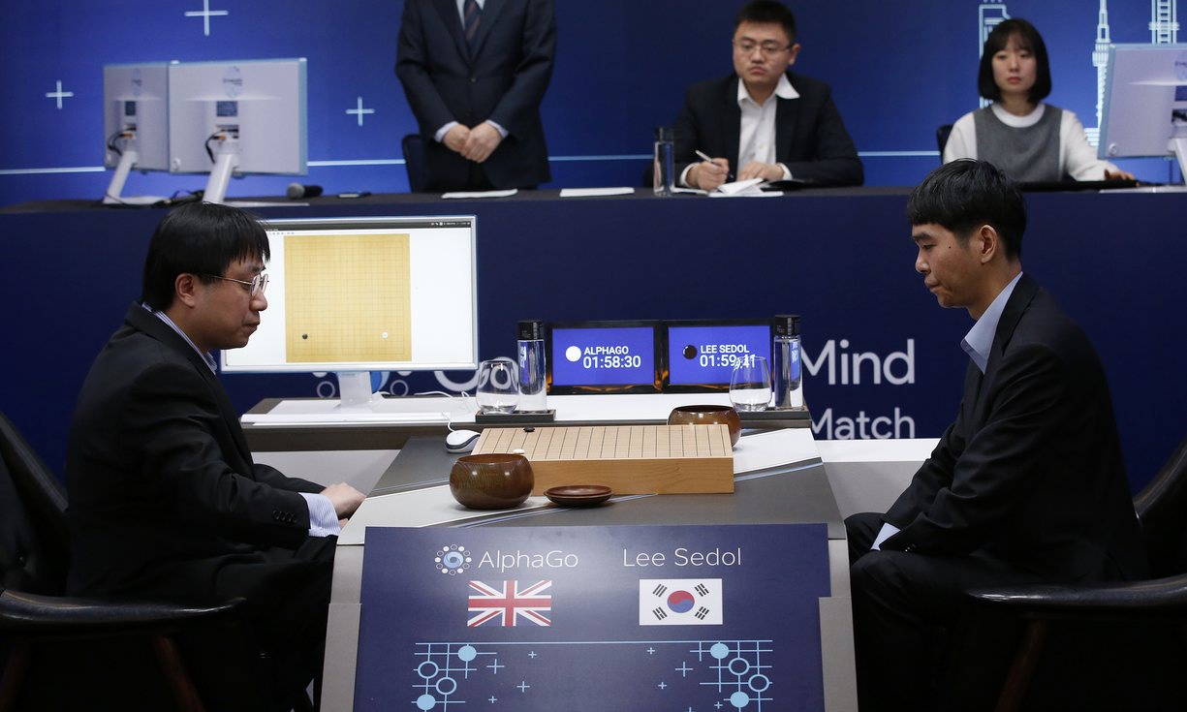

Slide 3
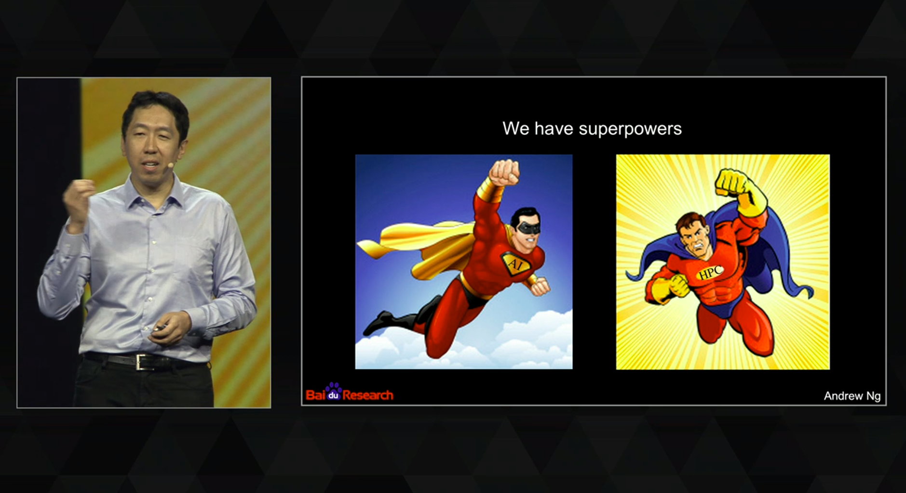
GPU Technology Conference 2015 - Dr. Andrew Ng

Slide 4
Audience
Want to understand basic machine learning (ML)
No/weak math/computer science background
y = Wx + b (y=ax+b)
Want to use ML as black-box with basic understanding
Want to use Tensorflow and Python (optional)

Slide 5
Goals
Basic understanding of machine learning algorithms
Linear regression, Logistic regression (classification)
Neural networks, Convolutional Neural Network, Recurrent Neural Network
Solve your problems using machine learning tools
Tensorflow and Python

Slide 6
Course structure
About 10 min Lecture
Programming tutorial using Tensorflow

Slide 8
Acknowledgement
Andrew Ng’s ML class
https://class.coursera.org/ml-003/lecture
http://www.holehouse.org/mlclass/ (note)
Convolutional Neural Networks for Visual Recognition.
http://cs231n.github.io/
TensorFlow
https://www.tensorflow.org
https://github.com/aymericdamien/TensorFlow-Examples

Slide 9
Schedule
Machine learning basic concepts
Linear regression
Logistic regression (classification)
Multivariable (Vector) linear/logistic regression
Neural networks
Deep learning
CNN
RNN
Bidirectional Neural networks

Slide 10
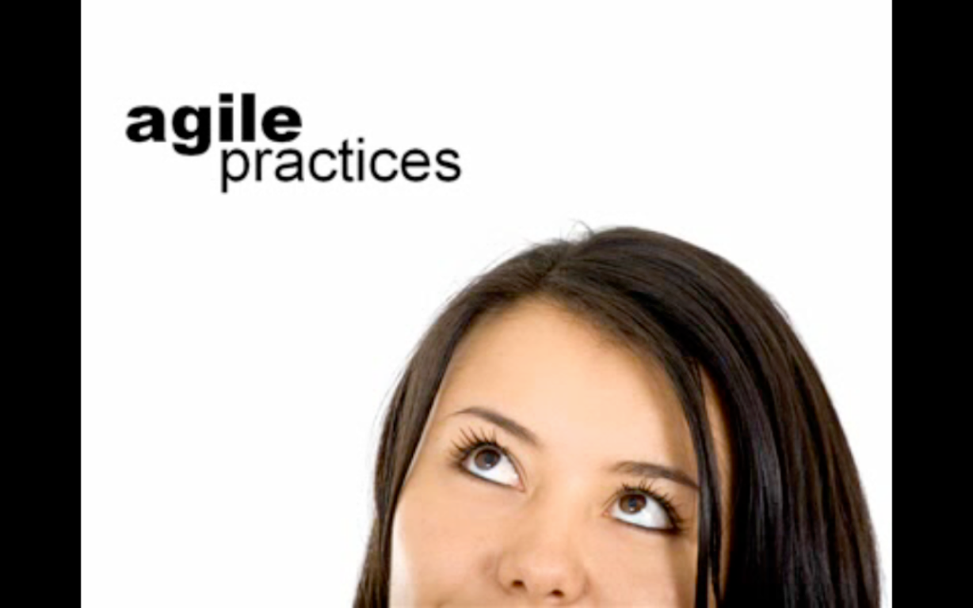
Next
ML basic concepts

